Slide 1
ML Model for ticket Booking
Exploratory Data Analysis, Data Cleaning, Findings, Predictive Model

Slide 2
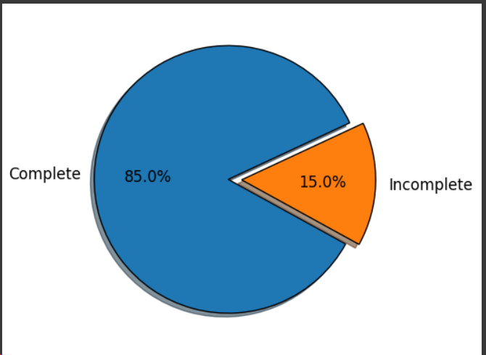
Most booked flights were completed as compared to incomplete

Slide 3
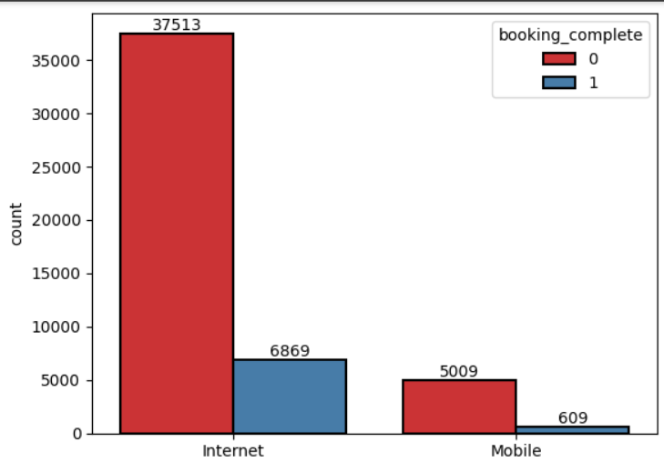
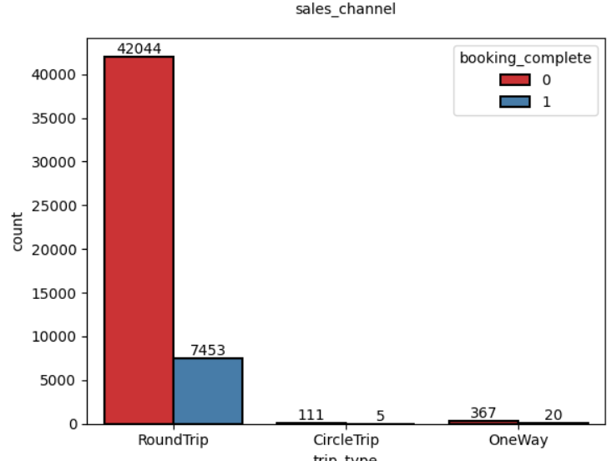
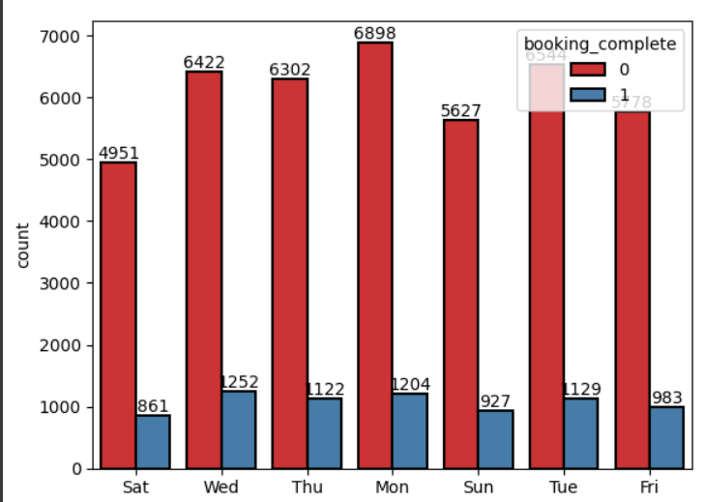
The most flights booked in Australia, Malaysia and South Korea
Most booked flights are internet
Roundtrip were more as compared to other
Most flights were booked on monday

Slide 4
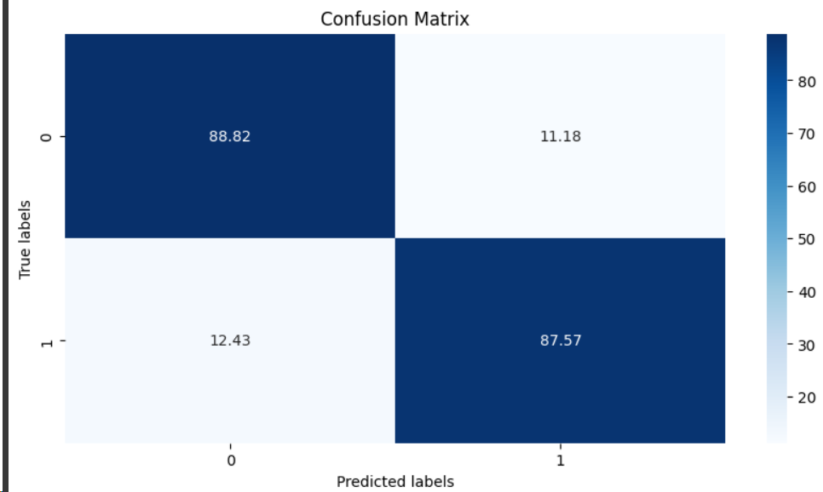
Used a random forest for predicting customer booking
Used 300 n-estimators, min-samples=10 ,min-sample-leaf=2 and max depth=None

